Slide 1
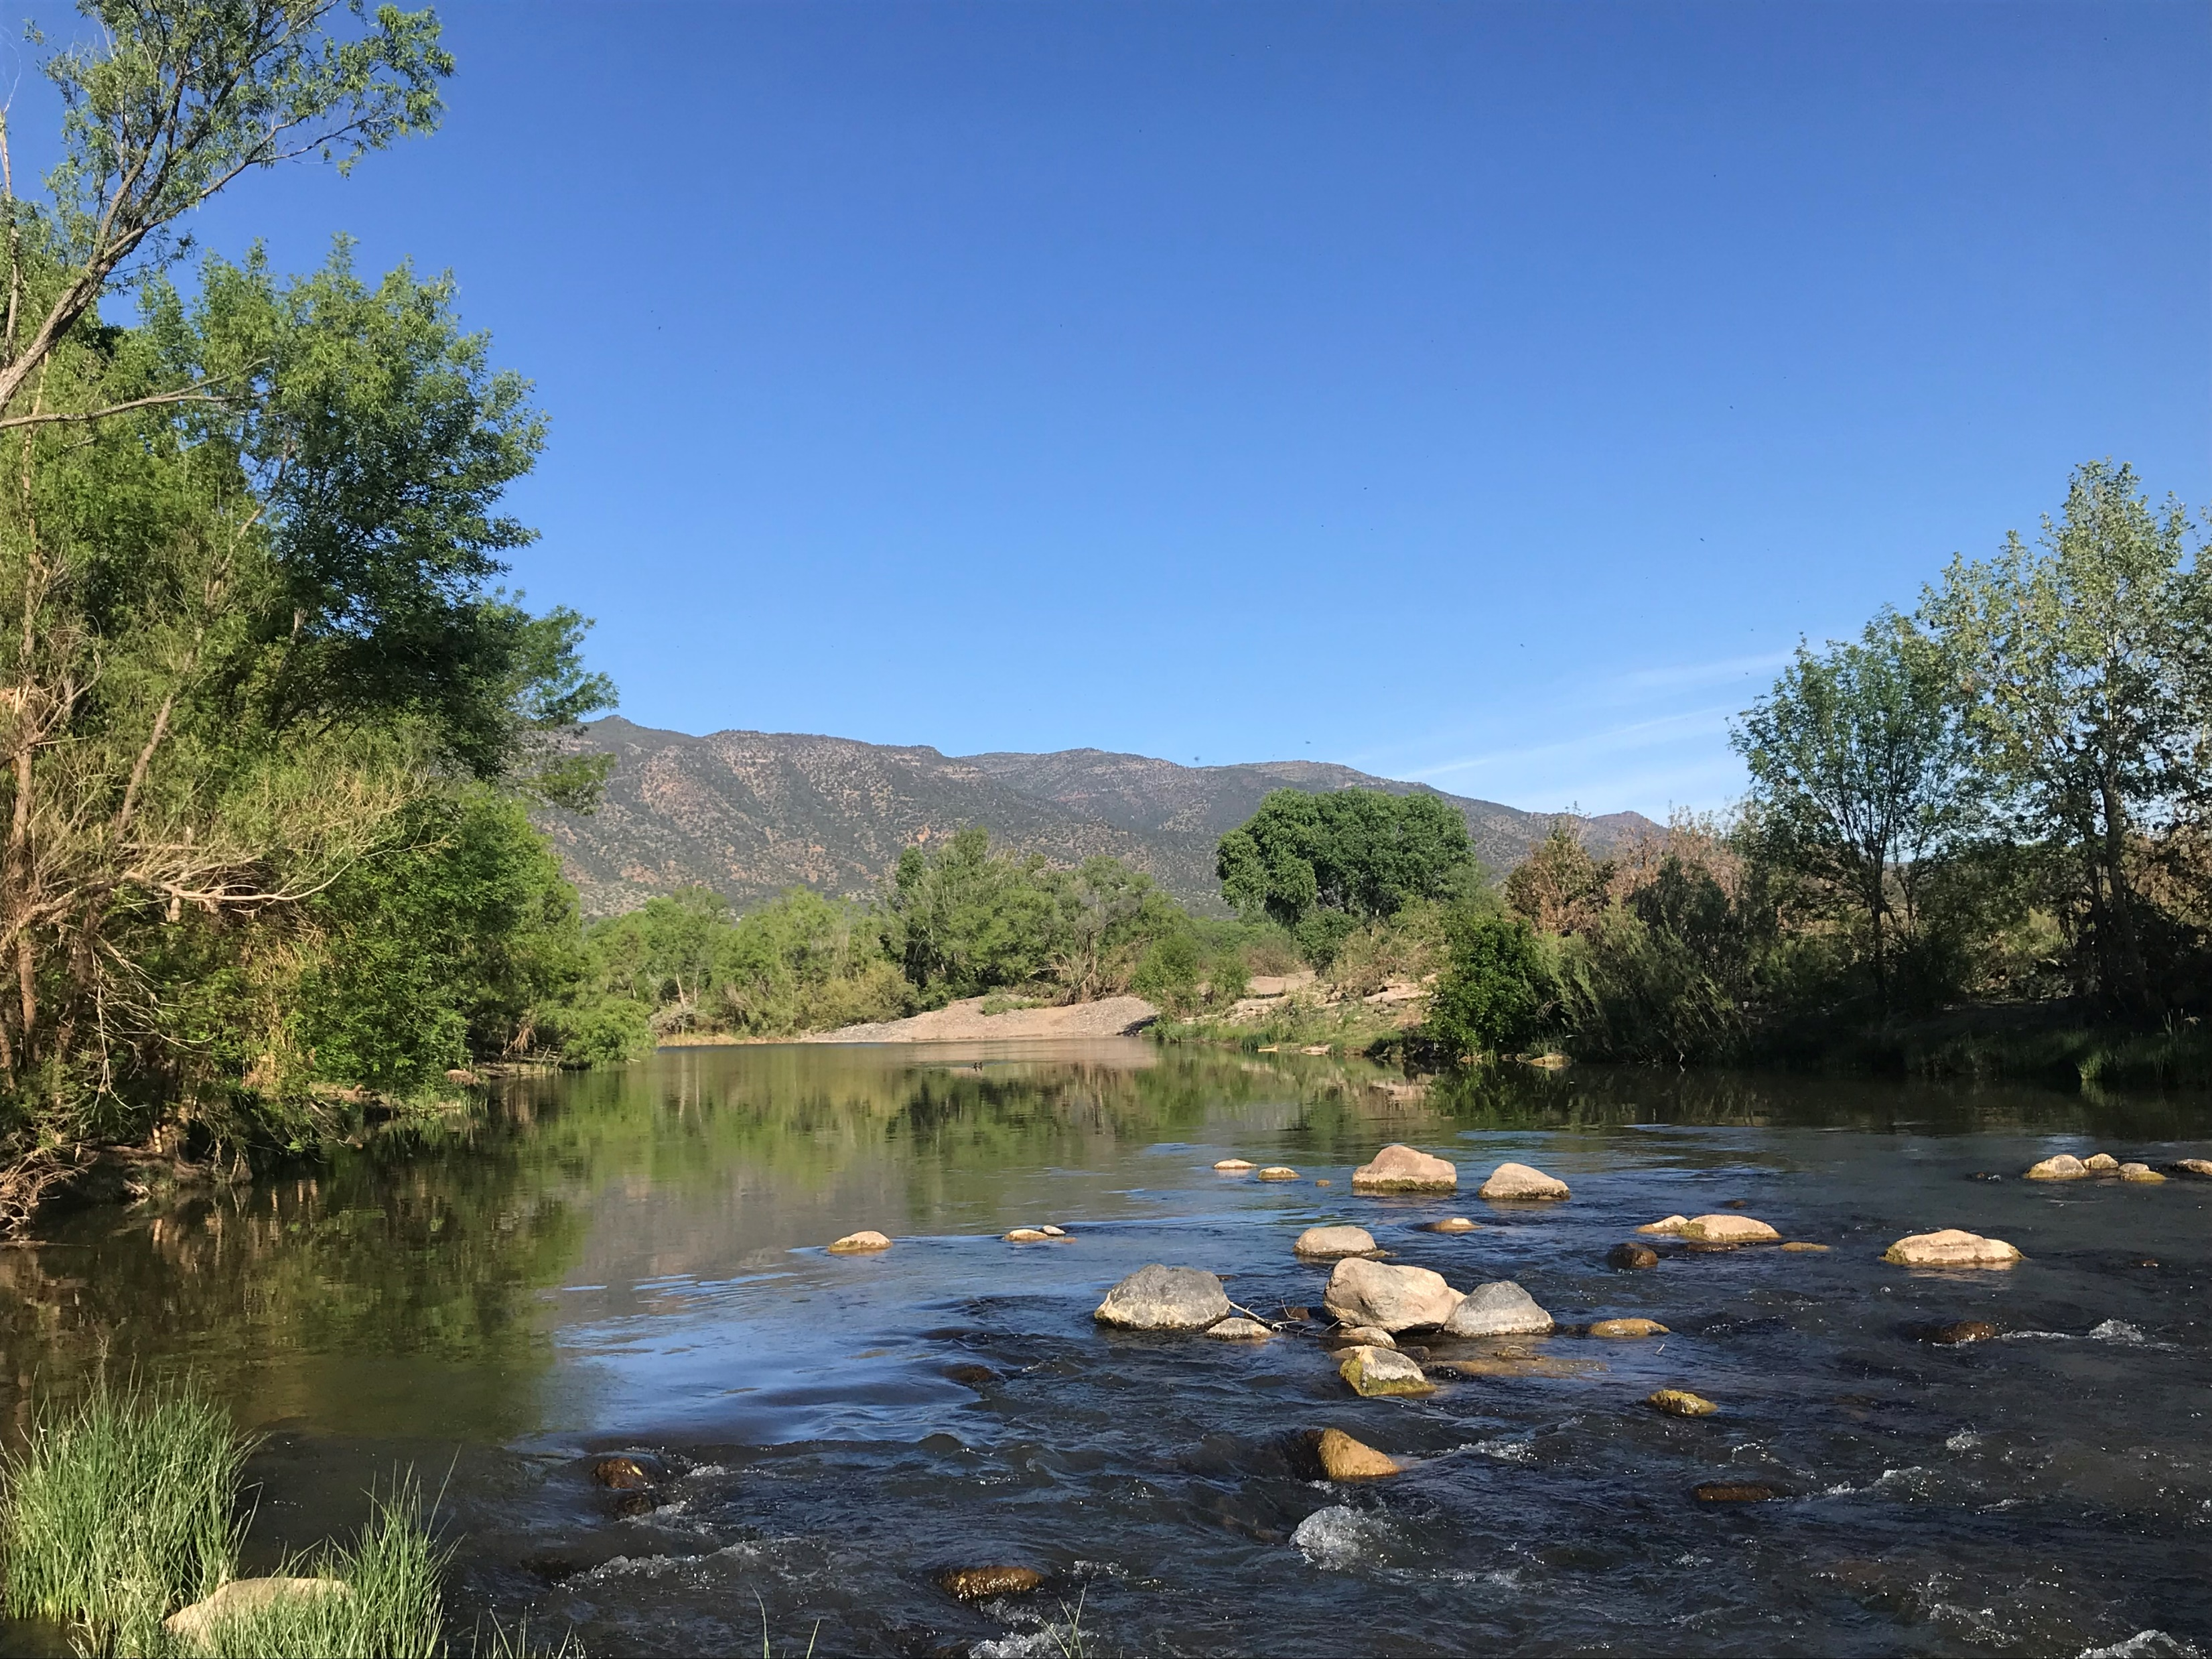
Week 6 Progress Report
Main scientific question being addressed:
How are aquatic invertebrate communities of the Verde River shaped by their environment at different spatial scales?
Between microhabitats (flowing water vs pools)
Between sites (reaches)
Between tributaries

Slide 2
Proposed Workflow
Every updated database gets dated
Version control crucial
Create species
and habitat matrices
Lowest taxonomic ranking
(no repeated species)
Field Work
(sample collection)
Data Collection
(sample processing)
Data Entry
Data Processing
Done
Data Analysis
Code organized and version
controlled on GIT
Data Presentation
Change parameters
to get desired result
Ordinations highlighting different
spatial scales

Slide 3
Goals
Get organized, learn how GIT works:
File naming and folder structure
Cleaning up old code and implementing clear and consistent coding practices
Do some analyses and make them reproducible and easily altered
Ordinations showing community structure at different spatial scales
Measures of diversity at different spatial scales
Learn how to use R markdown and how it could benefit my project

Slide 4
Achieved success
File organization and renaming
Habitat_Matrix2.csv Verde_HabMatrix_F17_S19.csv
Cleaning up old code with the goal of clarity and reproducibility
Making sure my comments are thorough enough that I could send this code to someone and they could understand what’s happening
Defining parameters that can be changed to alter outputs for easier alterations down the line (like text size, shape, color or even how data is being grouped)

Slide 5
Sticking points, failures, and challenges
Sticking points
GIT Hub file management, version control
Cleaning up code
Failures
R Markdown- Still haven’t used it (had to sift through errors, redownload R)
Coding best practices- The code I’ve revised has been easier to follow but there’s still work to be done- like following an established style, writing clear and concise messaging in R
Challenges: Time, not knowing little tricks to make things better or faster

